Slide 1
INTRODUCTION TO LOGISTIC REGRESSION
Abbas Chokor, Ph.D.
Staff Data Scientist, Seagate Technology

Slide 2
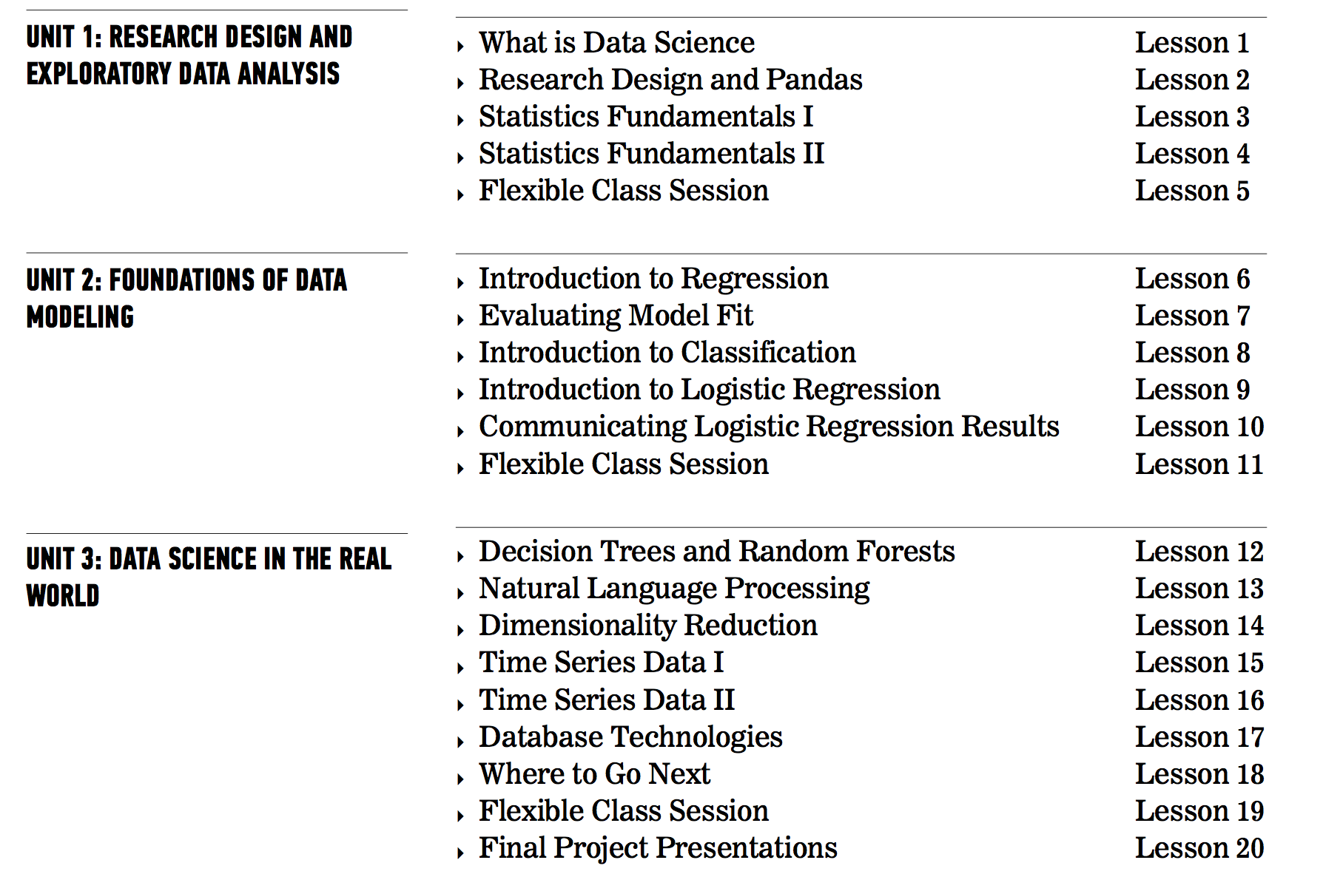
OUR PROGRESS SO FAR
Today’s Class

Slide 3
WHAT DID WE LEARN?
LAST CLASS
Define class label and classification
Build a K-Nearest Neighbors using the scikit-learn library
Evaluate and tune model by using metrics such as classification accuracy/error
You got all objectives?
Not all of them…
Let’s form groups of 1’s and 2’s …

Slide 4
ANNOUNCEMENTS
LAST CLASS
Mid-class survey
Moving to Rino Station starting next Thursday December 14th
Parking is free on the streets behind the Rino Station building, and all of your key fobs should work now at Rino Station as well
You will need to return your parking garage passes by next week.
is it really useful to have ore than one distance formula, minkowski, etc?
how are sklearn datasets structured?
?
I am still not sure what I am doing wrong on the formula for plotting the k vs s[1] to do optimization
Others?

Slide 5
REFRESH YOUR KNOWLEDGE
BIG
IMAGE
Notes:
5 min

Slide 6
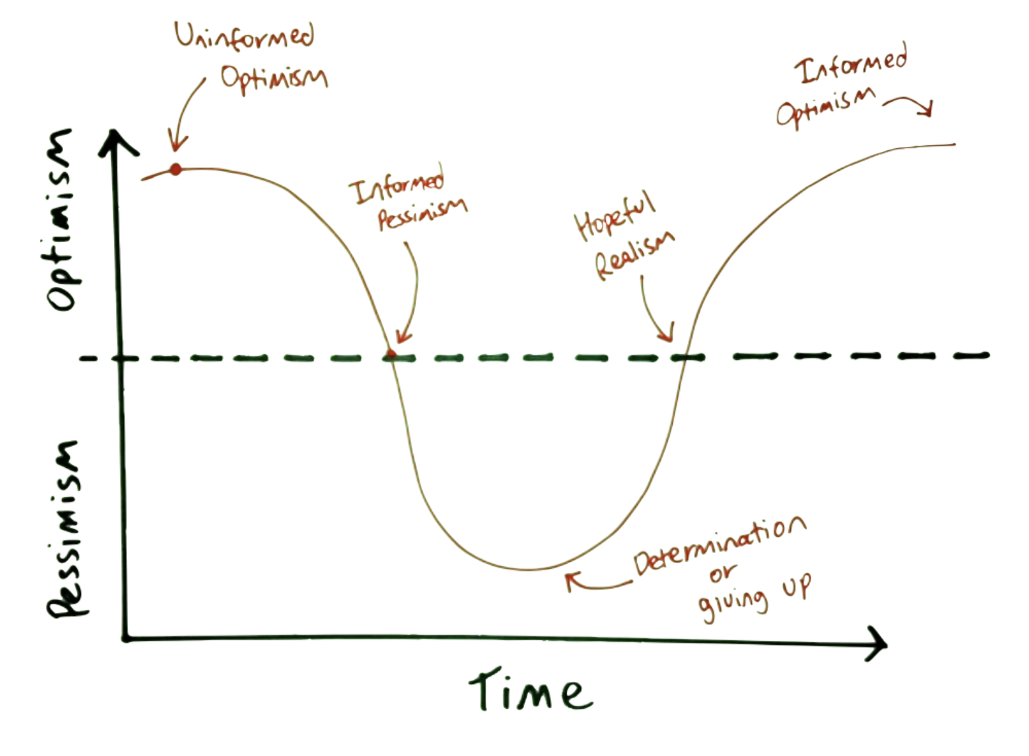
Where Are You Now?
CLASS EXPECTATIONS

Slide 7
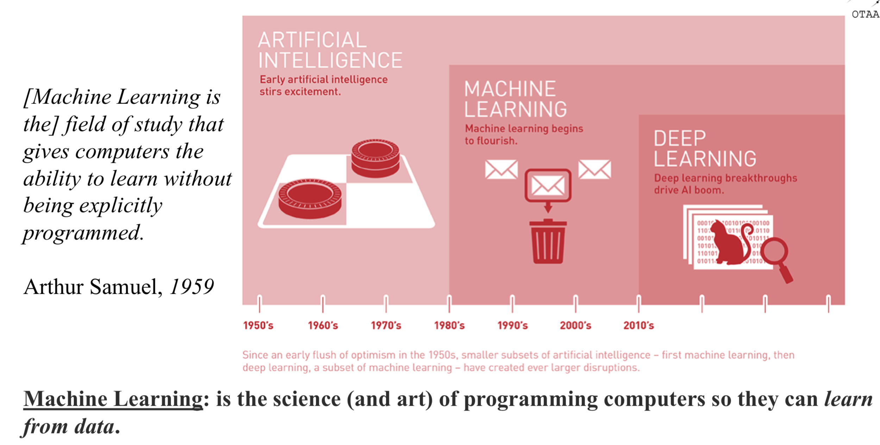
WHAT IS MACHINE LEARNING

Slide 8
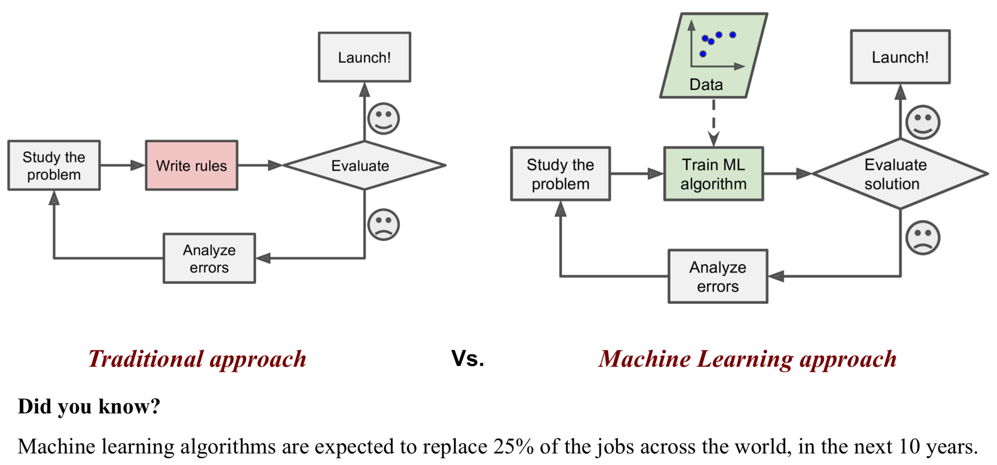
WHY TO USE MACHINE LEARNING?

Slide 9
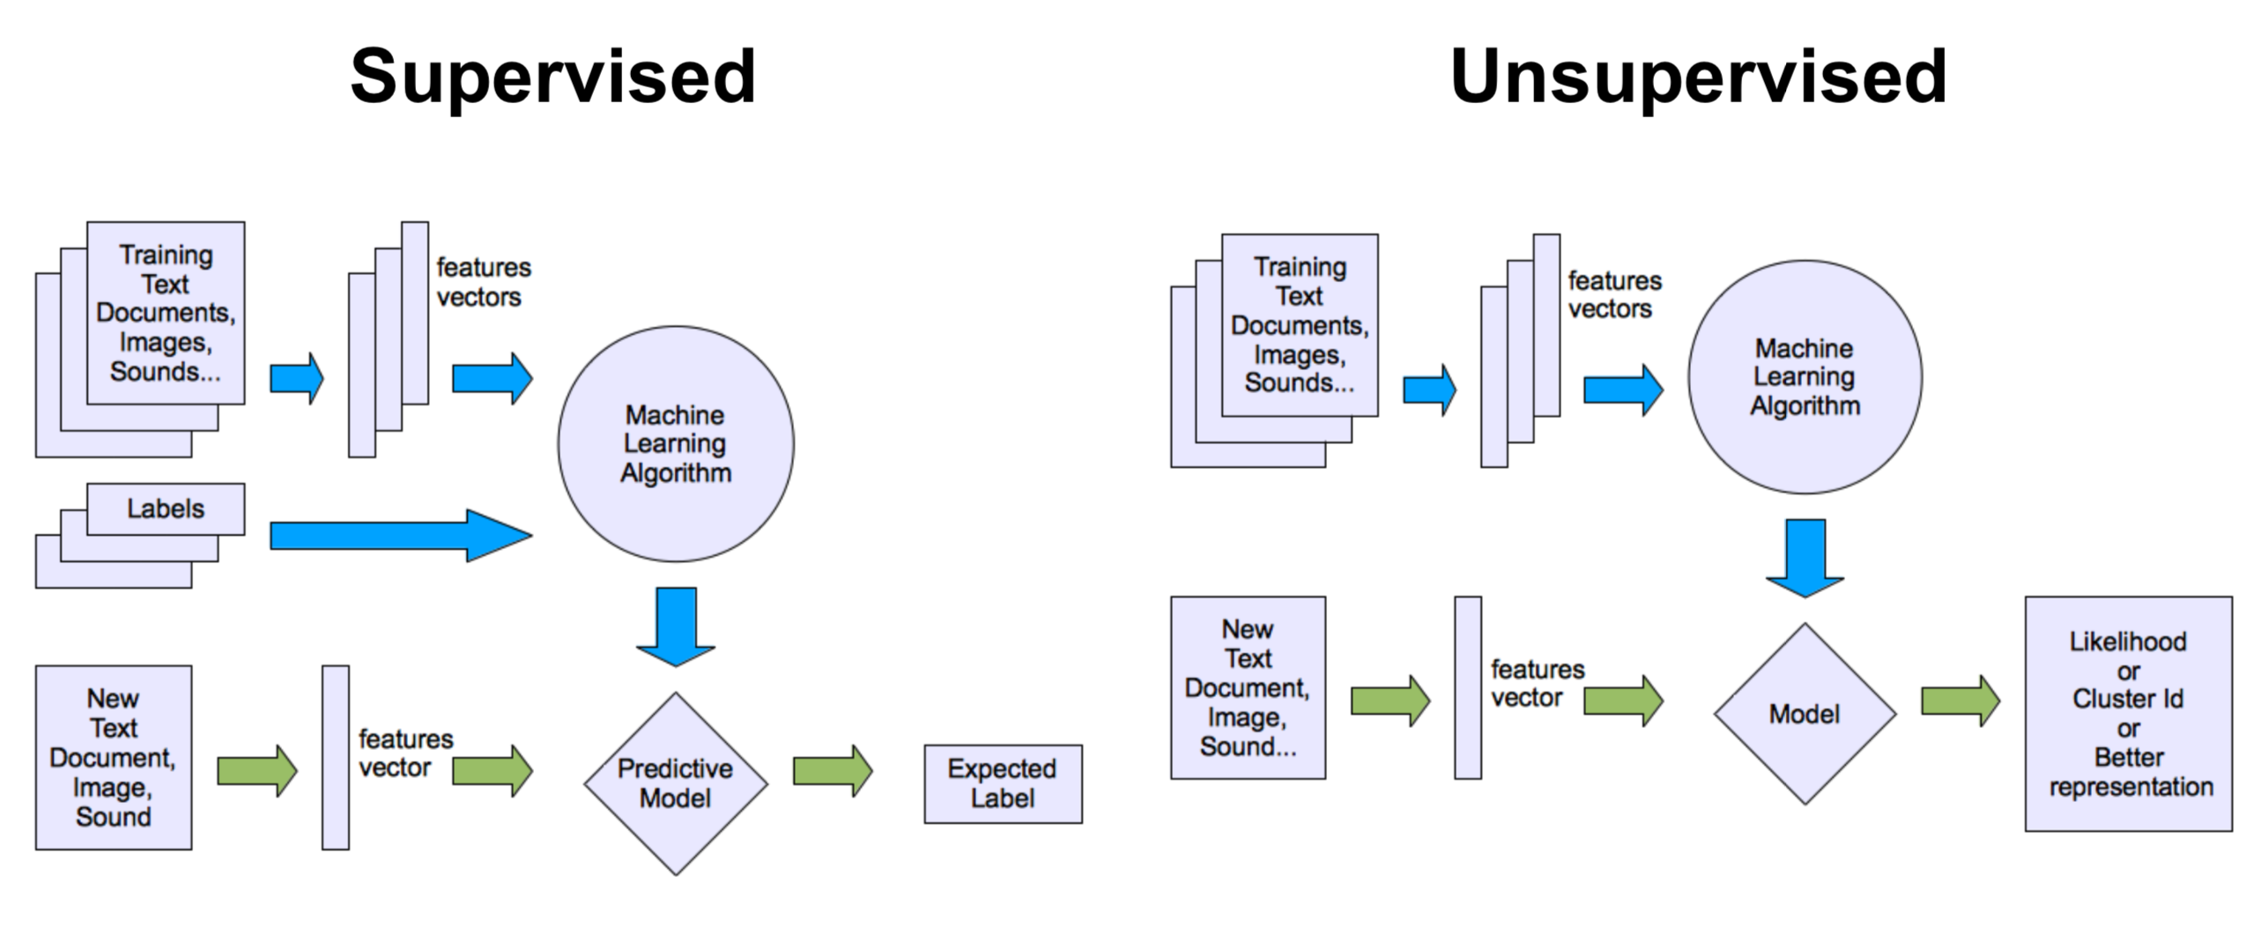
TYPES OF MACHINE LEARNING

Slide 10
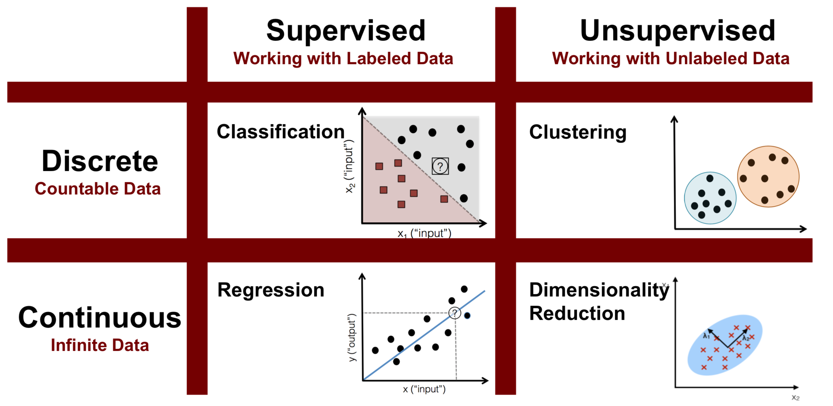
TYPES OF MACHINE LEARNING

Slide 11
TRAINING – VALIDATING - TESTING
Tune
Hyper-parameters

Slide 12
COURSE
PRE-WORK

Slide 13
PRE-WORK REVIEW
Did you do complete the Regression Quiz?
What R² and MSE you got?

Slide 14
LEARNING OBJECTIVES
INTRODUCTION TO LOGISTIC REGRESSION
Build a Logistic regression classification model using the statsmodels library
Describe a sigmoid function, odds, and the odds ratio as well as how they relate to logistic regression
Evaluate a model using metrics such as classification accuracy/error, confusion matrix, ROC/AUC curves, and loss functions
Logistic Regression
Sigmoid Function
ROC/AUC Curves

Slide 15
INTRODUCTION
LOGISTIC REGRESSION

Slide 16
LOGISTIC REGRESSION
Logistic regression is a linear approach to solving a classification problem.
That is, we can use a linear model, similar to Linear regression, in order to solve if an item belongs or does not belong to a class label.

Slide 17
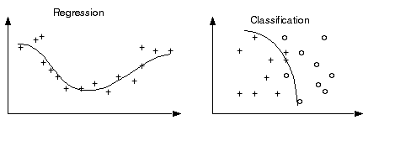
CHALLENGE! LINEAR REGRESSION RESULTS FOR CLASSIFICATION
Regression results can have a value range from -∞ to ∞.
Classification is used when predicted values (i.e. class labels) are not greater than or less than each other.

Slide 18
CHALLENGE! LINEAR REGRESSION RESULTS FOR CLASSIFICATION
But, since most classification problems are binary (0 or 1) and 1 is greater than 0, does it make sense to apply the concept of regression to solve classification?
How might we contain those bounds?

Slide 19
TO SUMMARIZE LOGISTIC REGRESSION
Linear Model
Sigmoid Function
y =
p / (1-p) represents the odds
ln (p / (1-p)) represents the log of odds

Slide 20
FIX 1: PROBABILITY
One approach is predicting the probability that an observation belongs to a certain class.
We could assume the prior probability of a class is the class distribution.

Slide 21
FIX 1: PROBABILITY
For example, suppose we know that roughly 700 of 2200 people from the Titanic survived. Without knowing anything about the passengers or crew, the probability of survival would be ~0.32 (32%).
However, we still need a way to use a linear function to either increase or decrease the probability of an observation given the data about it.

Slide 22
FIX 2: LINK FUNCTIONS AND THE SIGMOID FUNCTION
Another advantage to OLS is that it allows for generalized models using a link function.
Link functions allows us to build a relationship between a linear function and the mean of a distribution.
We can now form a specific relationship between our linear predictors and the response variable.

Slide 23
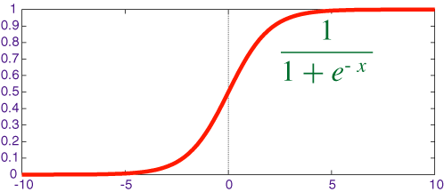
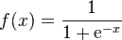
FIX 2: LINK FUNCTIONS AND THE SIGMOID FUNCTION
A sigmoid function is a function that visually looks like an s.
Mathematically, it is defined as

Slide 24
FIX 2: LINK FUNCTIONS AND THE SIGMOID FUNCTION
Recall that e is the inverse of the natural log.
As x increases, the results is closer to 1. As x decreases, the result is closer to 0.
When x = 0, the result is 0.5.

Slide 25
FIX 2: LINK FUNCTIONS AND THE SIGMOID FUNCTION
Since x decides how much to increase or decrease the value away from 0.5, x can be interpreted as something like a coefficient.
However, we still need to change its form to make it more useful.

Slide 26
DEMO
PLOTTING ODDS, LOG ODDS, AND SIGMOID FUNCTIONS

Slide 27
PLOTTING A SIGMOID FUNCTION
Open the “basics” in lesson 9 - code
Recall that e = 2.71.
Do we get an the “S” shape we expect?

Slide 28
INTRODUCTION
LOGISTIC REGRESSION

Slide 29
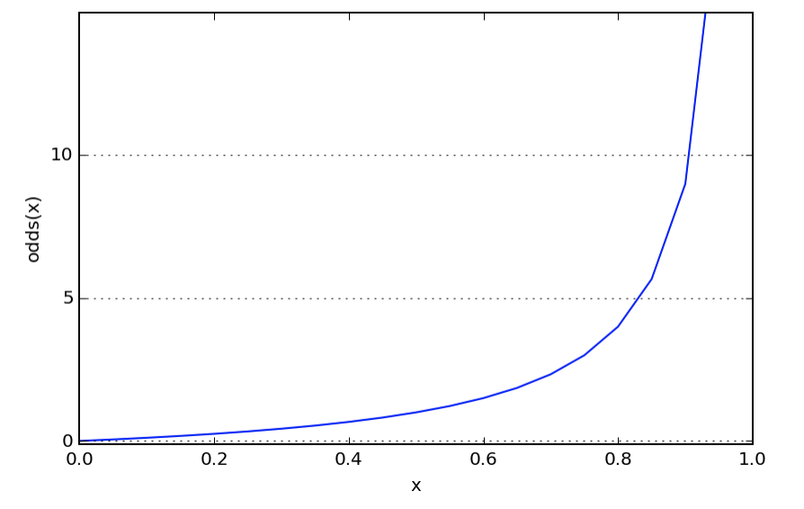
FIX 3: ODDS AND LOG-ODDS

Slide 30
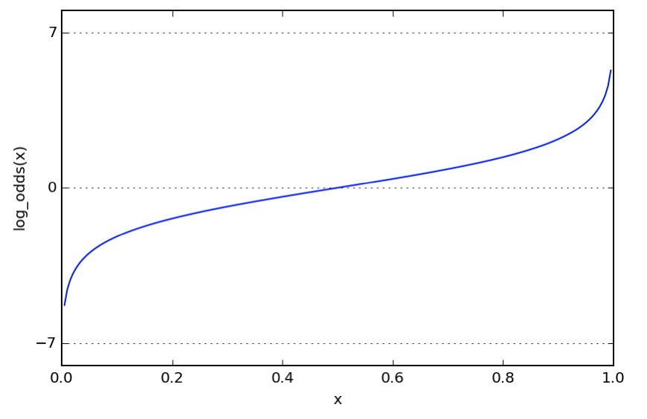
FIX 3: ODDS AND LOG-ODDS

Slide 31
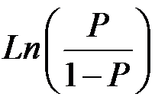
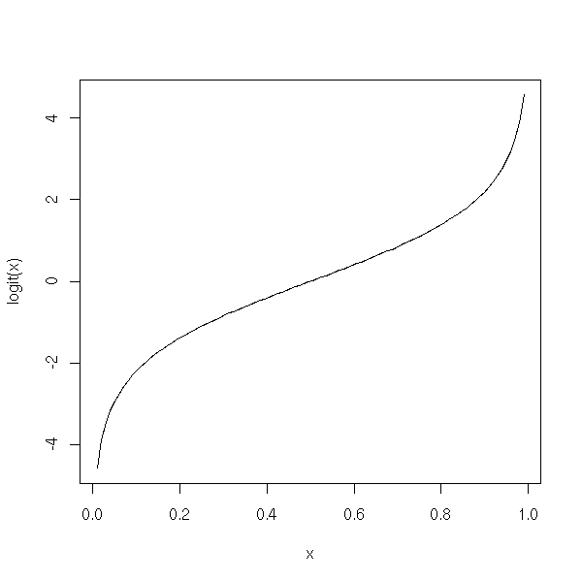
FIX 3: ODDS AND LOG-ODDS
The logit function is the inverse of the sigmoid function.
This will act as our link function for logistic regression.
Mathematically, the logit function is defined as

Slide 32
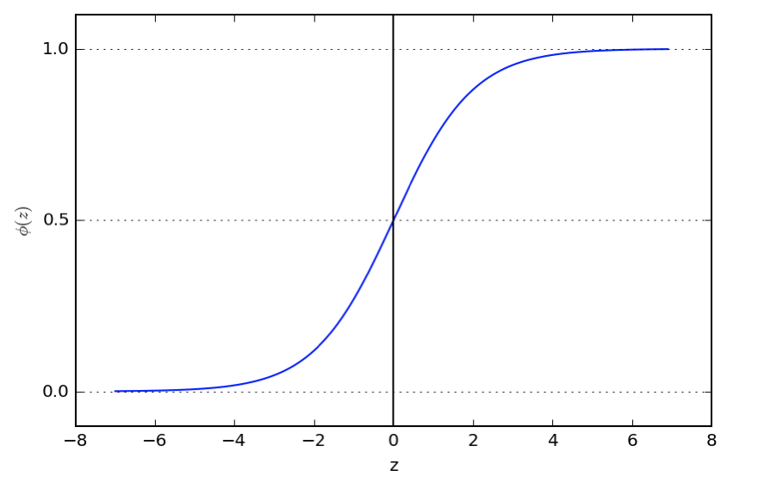
FIX 3: ODDS AND LOG-ODDS

Slide 33
TO SUMMARIZE LOGISTIC REGRESSION
Linear Model
Sigmoid Function

Slide 34
INDEPENDENT PRACTICE
LOGISTIC REGRESSION IMPLEMENTATION

Slide 35

ACTIVITY: LOGISTIC REGRESSION IMPLEMENTATION
DIRECTIONS (Part A of Starter Code)
EXERCISE
Use the data collegeadmissions.csv and to predict the target variable admit.
Build a simple model with one feature and explore the coef_ value. Does this represent the odds or logit (log odds)?
DELIVERABLE
Answers to the above questions

Slide 36
INTRODUCTION
ADVANCED CLASSIFICATION METRICS

Slide 37
ADVANCED CLASSIFICATION METRICS
Accuracy is only one of several metrics used when solving a classification problem.
Accuracy = total predicted correct / total observations in dataset
Accuracy alone doesn’t always give us a full picture.
If we know a model is 75% accurate, it doesn’t provide any insight into why the 25% was wrong.

Slide 38
ADVANCED CLASSIFICATION METRICS
Was it wrong across all labels?
Did it just guess one class label for all predictions?
It’s important to look at other metrics to fully understand the problem.

Slide 39
ADVANCED CLASSIFICATION METRICS
We can split up the accuracy of each label by using the true positive rate and the false positive rate.
For each label, we can put it into the category of a true positive, false positive, true negative, or false negative.

Slide 40
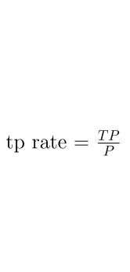
ADVANCED CLASSIFICATION METRICS
True Positive Rate (TPR) asks, “Out of all of the target class labels, how many were accurately predicted to belong to that class?”
For example, given a medical exam that tests for cancer, how often does it correctly identify patients with cancer?

Slide 41
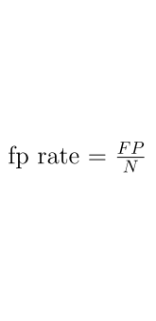
ADVANCED CLASSIFICATION METRICS
False Positive Rate (FPR) asks, “Out of all items not belonging to a class label, how many were predicted as belonging to that target class label?”
For example, given a medical exam that tests for cancer, how often does it trigger a “false alarm” by incorrectly saying a patient has cancer?

Slide 42
ADVANCED CLASSIFICATION METRICS
The true positive and false positive rates gives us a much clearer pictures of where predictions begin to fall apart.
This allows us to adjust our models accordingly.

Slide 43
ADVANCED CLASSIFICATION METRICS
A good classifier would have a true positive rate approaching 1 and a false positive rate approaching 0.
In our smoking problem, this model would accurately predict all of the smokers as smokers and not accidentally predict any of the nonsmokers as smokers.

Slide 44
ADVANCED CLASSIFICATION METRICS
We can vary the classification threshold for our model to get different predictions. But how do we know if a model is better overall than other model?
We can compare the FPR and TPR of the models, but it can often be difficult to optimize two numbers at once.
Logically, we like a single number for optimization.
Can you think of any ways to combine our two metrics?

Slide 45
ADVANCED CLASSIFICATION METRICS
This is where the Receiver Operation Characteristic (ROC) curve comes in handy.
The curve is created by plotting the true positive rate against the false positive rate at various model threshold settings.
Area Under the Curve (AUC) summarizes the impact of TPR and FPR in one single value.

Slide 46
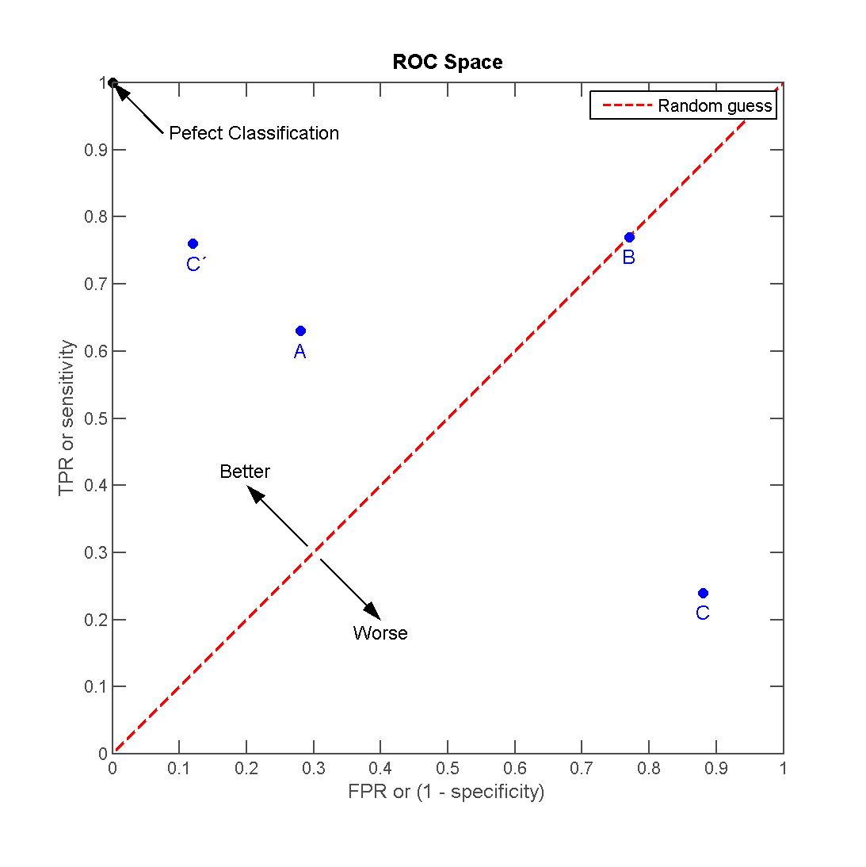
ADVANCED CLASSIFICATION METRICS
There can be a variety of points on an ROC curve.

Slide 47
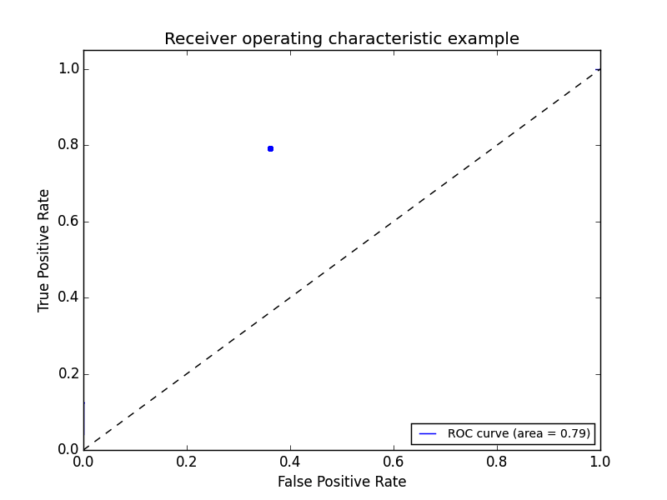
ADVANCED CLASSIFICATION METRICS
We can begin by plotting an individual TPR/FPR pair for one threshold.

Slide 48
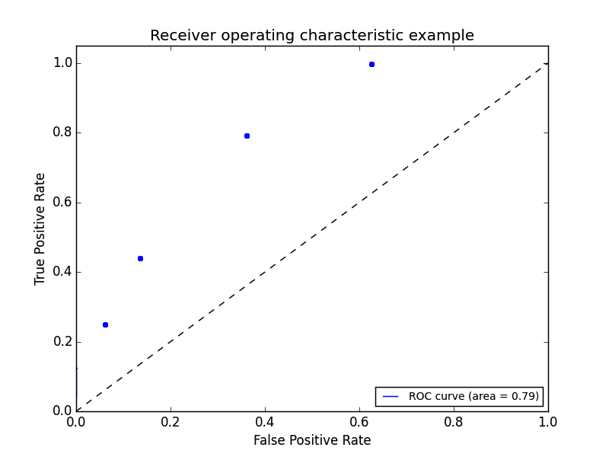
ADVANCED CLASSIFICATION METRICS
We can continue adding pairs for different thresholds

Slide 49
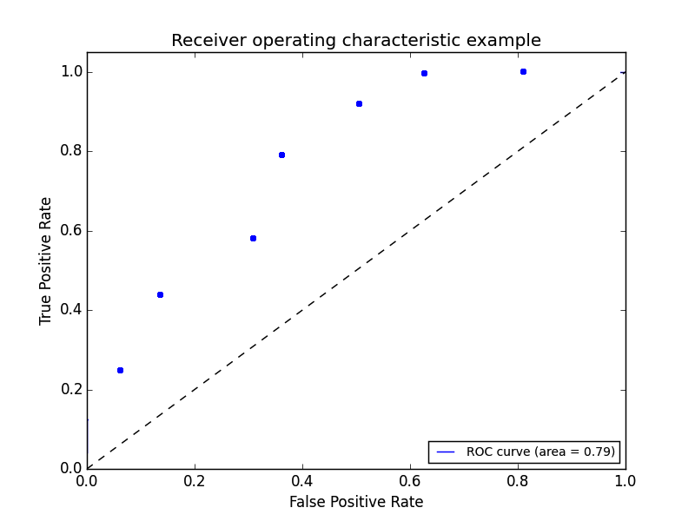
ADVANCED CLASSIFICATION METRICS
We can continue adding pairs for different thresholds

Slide 50
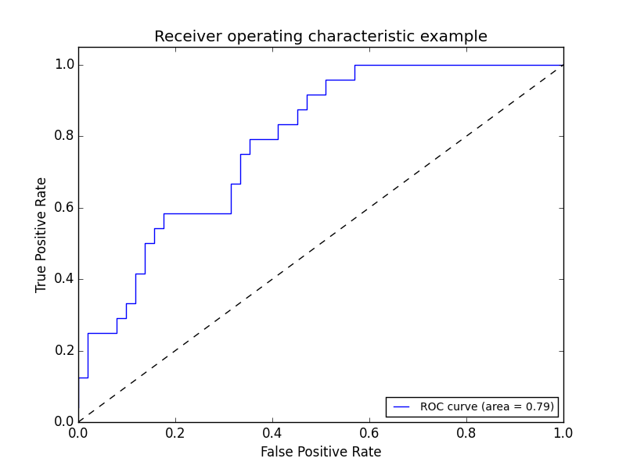
ADVANCED CLASSIFICATION METRICS
Finally, we create a full curve that is described by TPR and FPR.

Slide 51
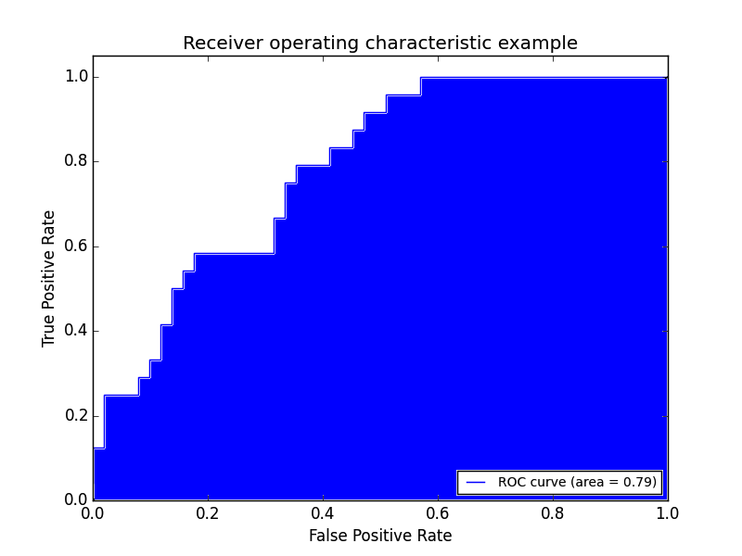
ADVANCED CLASSIFICATION METRICS
With this curve, we can find the Area Under the Curve (AUC).

Slide 52
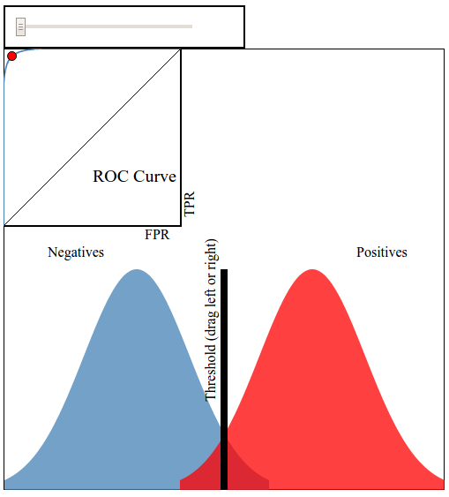
ADVANCED CLASSIFICATION METRICS
This interactive visualization can help practice visualizing ROC curves.

Slide 53
ADVANCED CLASSIFICATION METRICS
If we have a TPR of 1 (all positives are marked positive) and FPR of 0 (all negatives are not marked positive), we’d have an AUC of 1. This means everything was accurately predicted.
If we have a TPR of 0 (all positives are not marked positive) and an FPR of 1 (all negatives are marked positive), we’d have an AUC of 0. This means nothing was predicted accurately.
An AUC of 0.5 would suggest randomness (somewhat) and is an excellent benchmark to use for comparing predictions (i.e. is my AUC above 0.5?).

Slide 54
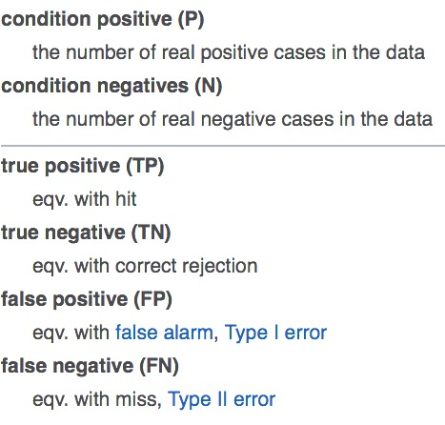
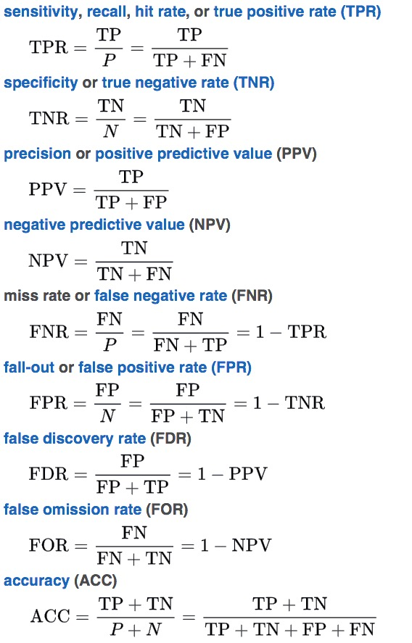
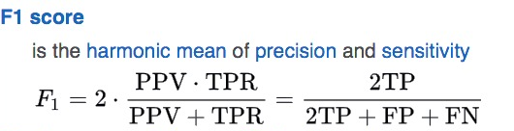
ADVANCED CLASSIFICATION METRICS
There are several other common metrics that are similar to TPR and FPR.

Slide 55
GUIDED PRACTICE
WHICH METRIC SHOULD I USE?

Slide 56
ACTIVITY: WHICH METRIC SHOULD I USE?
DIRECTIONS
EXERCISE
- Complete Part B of the starter code
- While AUC seems like a “golden standard”, it could be further improved depending upon your problem. There will be instances where error in positive or negative matches will be very important. For each of the following examples:
Write a confusion matrix: true positive, false positive, true negative, false negative. Then decide what each square represents for that specific example.
Define the benefit of a true positive and true negative.
Define the cost of a false positive and false negative.
Determine at what point does the cost of a failure outweigh the benefit of a success? This would help you decide how to optimize TPR, FPR, and AUC.
DELIVERABLE
Answers for each example

Slide 57
ACTIVITY: WHICH METRIC SHOULD I USE?
DIRECTIONS
EXERCISE
Examples:
A test is developed for determining if a patient has cancer or not.
A newspaper company is targeting a marketing campaign for "at risk" users that may stop paying for the product soon.
You build a spam classifier for your email system.
DELIVERABLE
Answers for each example

Slide 58
INDEPENDENT PRACTICE
EVALUATING LOGISTIC REGRESSION WITH ALTERNATIVE METRICS

Slide 59
ACTIVITY: EVALUATING LOGISTIC REGRESSION
DIRECTIONS
EXERCISE
In part C of the code, let’s explore survival data from the Titanic.
Spend a few minutes determining which data would be most important to use in the prediction problem.
Build a tuned Logistic model. Be prepared to explain your design (including regularization), metric, and feature set in predicting survival using any tools necessary (such as a fit chart). Use the starter code to get you going.
DELIVERABLE
Answers to the above question and a Logistic model on the Titanic data

Slide 60
CONCLUSION
TOPIC REVIEW

Slide 61
REVIEW QUESTIONS
What’s the link function used in logistic regression?
What kind of machine learning problems does logistic regression address?
What do the coefficients in a logistic regression represent? How does the interpretation differ from ordinary least squares? How is it similar?

Slide 62
REVIEW QUESTIONS
How does True Positive Rate and False Positive Rate help explain accuracy?
What would an AUC of 0.5 represent for a model? What about an AUC of 0.9?
Why might one classification metric be more important to tune than another? Give an example of a business problem or project where this would be the case.

Slide 63
TIPS FOR LOGISITC REGRESSION
Pros:
Easy to interpret – the idea of regression is familiar and intuitive
Low variance
Provides probabilities for outcomes
Cons:
Dependent variables to be categorical in nature
Doesn’t handle large number of categorical features well
Relies on transformations for non-linear features

Slide 64
COURSE
BEFORE NEXT CLASS

Slide 65
OUR PROGRESS SO FAR
Next Class

Slide 66
DUE DATE
BEFORE NEXT CLASS
Project: Unit Project 3 due Thursday Dec 14th

Slide 67
LESSON
Q & A

Slide 68
LESSON
EXIT TICKET
DON’T FORGET TO FILL OUT YOUR EXIT TICKET

